Slide 1





EXPERTS LIVE
26TH JULY 2024 NAIROBI, KENYA

Slide 2








Azure on a Budget
Stan Ionițoiu-Janssen
System Architect & Microsoft Certified Trainer

Slide 3
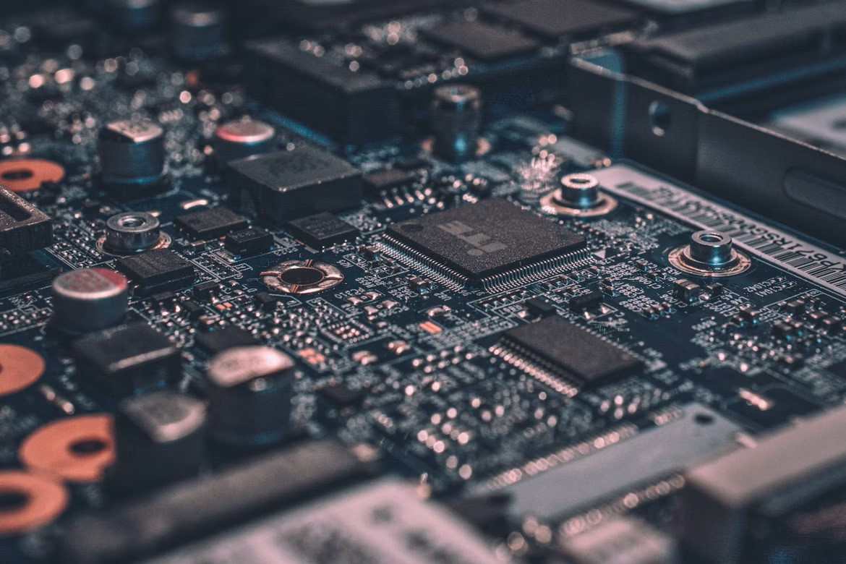

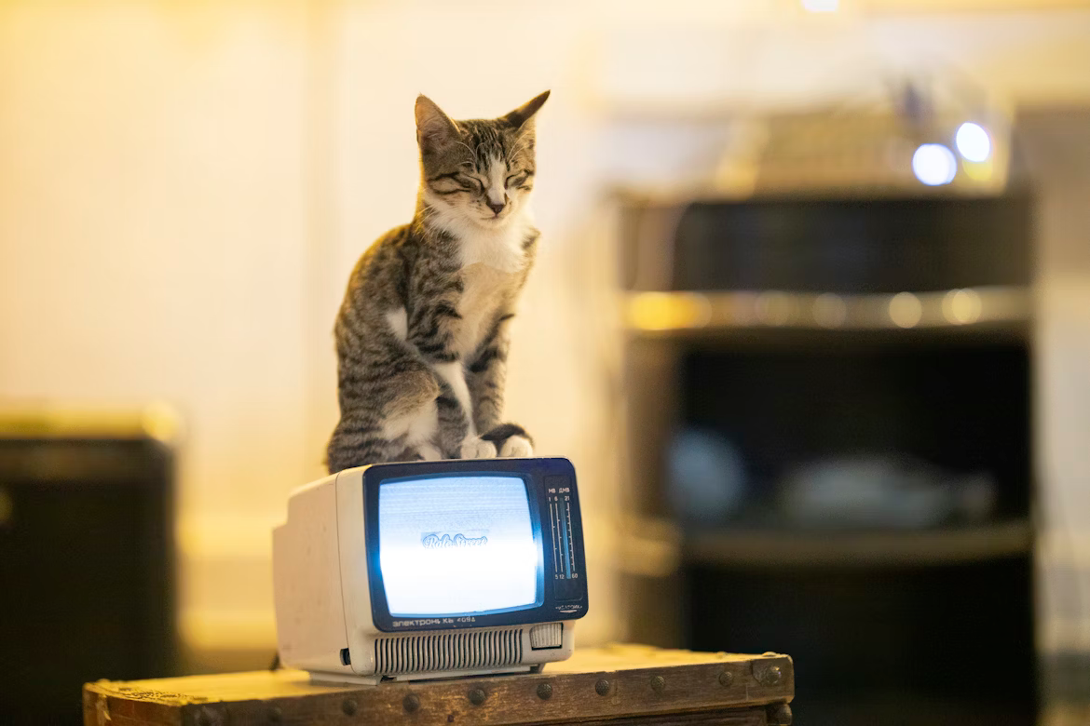
Notes:
Ten years ago, in the spring of 2014, I was dabbling with
Home servers, building my own computers
Home automation, incl. custom Python scripts to make my smart lights into wake-up lights
And helping others (family, friends) with their IT woes

Slide 4
Notes:
Ten years ago, in the spring of 2014, I was dabbling with
Home servers, building my own computers
Home automation, incl. custom Python scripts to make my smart lights into wake-up lights
And helping others (family, friends) with their IT woes

Slide 5
Notes:
Ten years ago, in the spring of 2014, I was dabbling with
Home servers, building my own computers
Home automation, incl. custom Python scripts to make my smart lights into wake-up lights
And helping others (family, friends) with their IT woes

Slide 6
Notes:
Ten years ago, in the spring of 2014, I was dabbling with
Home servers, building my own computers
Home automation, incl. custom Python scripts to make my smart lights into wake-up lights
And helping others (family, friends) with their IT woes

Slide 7

Notes:
Who here is a developer?
Anyone working on personal projects?
Using Azure? Other methods?

Slide 8

Ideation

Slide 9



Notes:
Around that time, I also discovered two new hobbies
Reddit
Whisky
Turns out there’s a nice community on doing Whisky Reviews

Slide 10
Notes:
Now if we take those whisky reviews, add a little bit of data magic. We can make ourselves a nice little bot right?

Slide 11



Notes:
Now if we take those whisky reviews, add a little bit of data magic. We can make ourselves a nice little bot right?

Slide 12

Notes:
Now if we take those whisky reviews, add a little bit of data magic. We can make ourselves a nice little bot right?

Slide 13
Implementation

Slide 14
Notes:
Any Data scientists / Engineers / Specialists in the room?
What do we need for text classification?

Slide 15
Review Data
Welcome, Stan! (20 – 30)
Aberlour 18
Review (y)
Comment (n)
Aberlour 18
Review (y)
Comment (n)
by SomeWhiskySnob
by AnotherWhiskyLover
Review: #27 Aberlour 18 double cask matured (blind)
Details: My first taste of anything Aberlour, poured by the lady friend with notes taken blind. Rested neat for 10 min in a glencairn.
Nose: Musty wine, dark fruits, pears, vanilla, oak
Taste: Vanilla, butterscotch, bitter oak, that musty flavor again. sherry? Some odd spicy candy note, it reminds me of those weird candies they sell in old timey stores that kids buy without knowing they won't taste sweet
Finish: The spicy candy keeps going, tingles a good long while, tobacco combines with oak, like licking a humidor. Jumps from mostly sweet on the palate to a spicy finish very quickly
Overall: I did not guess scotch at all for this one. I remember this being very different and a lot sweeter when I first bought and opened it. The sherry(hah what a wine note) is very present, but this does a great job of showing the other cask as well and had me fooled. I think sherry casks might be something to keep looking for next liquor trip, I'm very happy with this
Thanks for reading!
Rank: 7
Would be interested to know for sure. I assume 18 year old whisky with a lot of that time spent in sherry casks would not need any artificial colouring to get that dark. I also think it looks slightly different to the normal e150 colour to me, a slightly more red darkness, but I'm definitely no expert.
Notes:
Create a website
Add a login with Reddit
Display latest comments
Add some buttons with shortcuts for easy reviewing

Slide 16


Slide 17

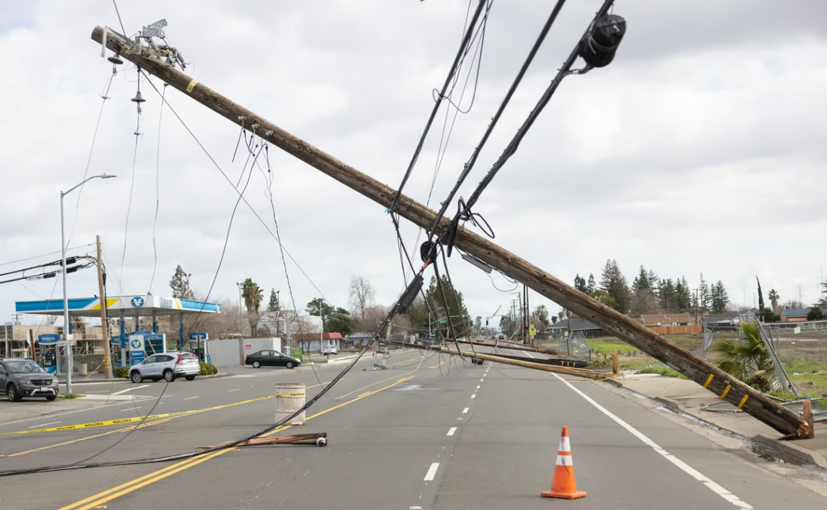


Slide 18
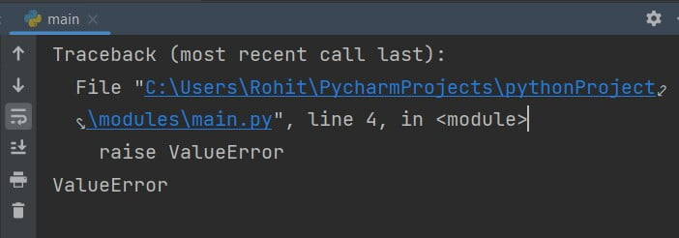
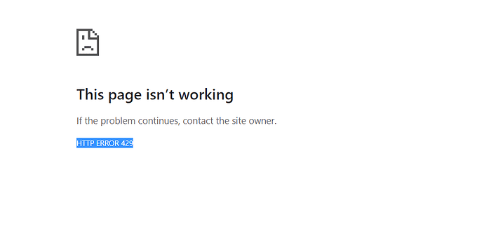

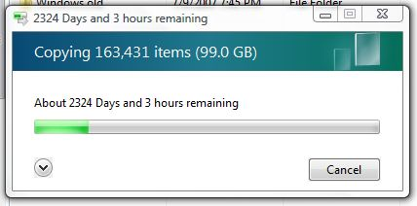

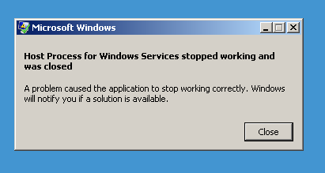
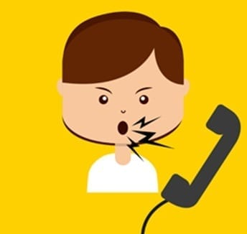

Slide 19
Elevation

Slide 20
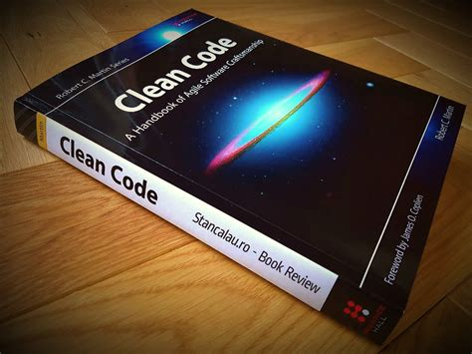

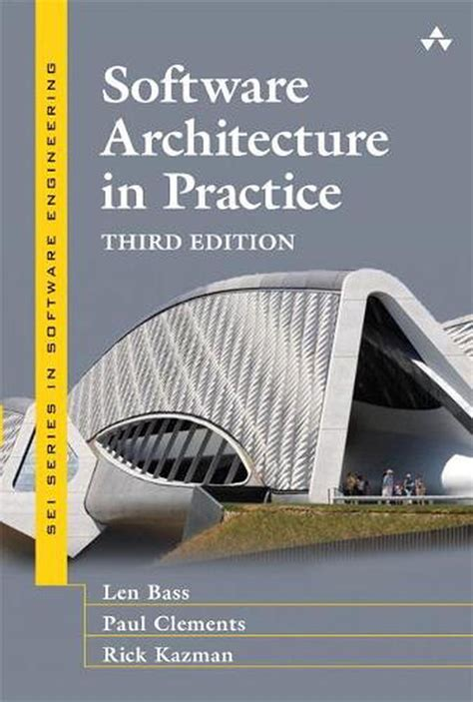
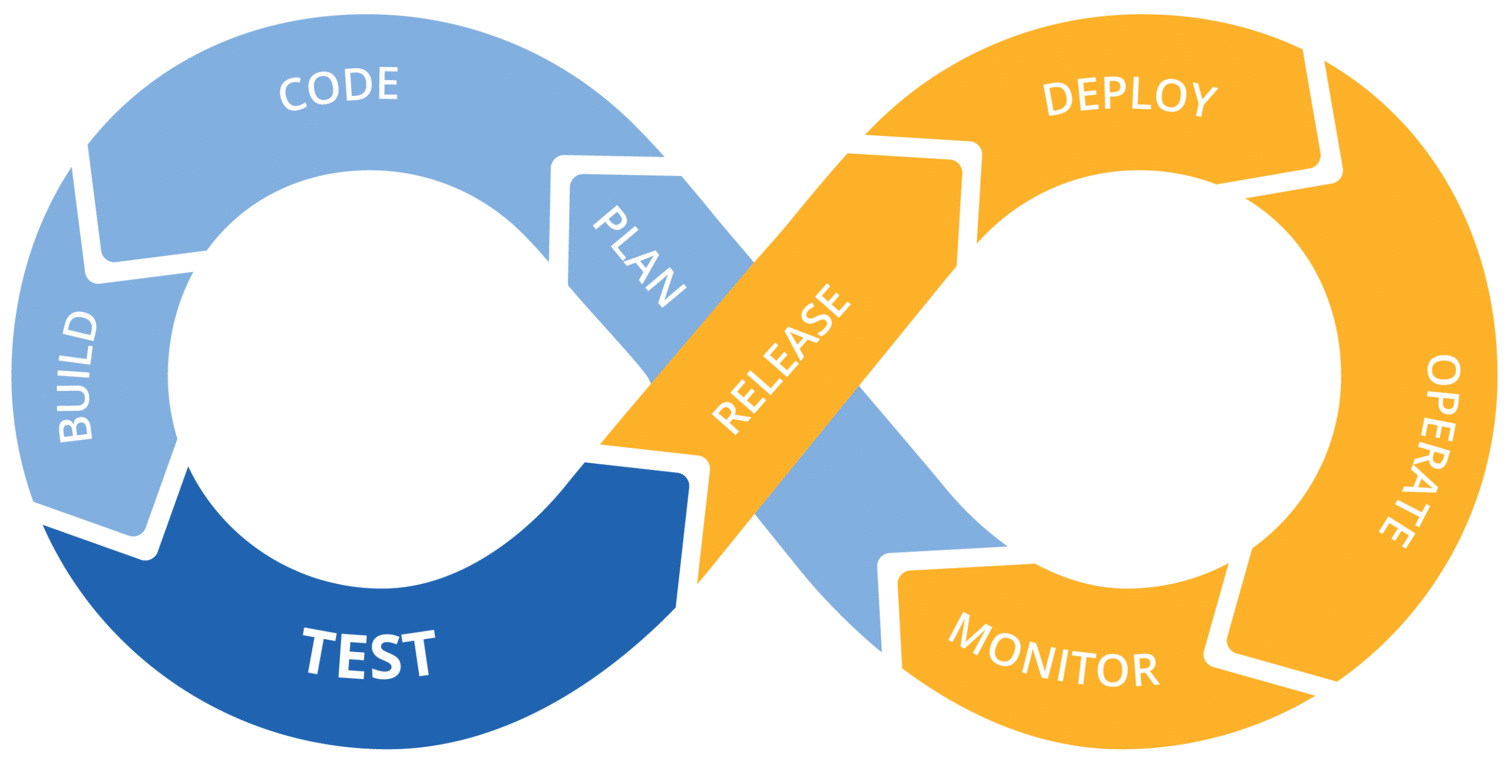

Slide 21





Slide 22
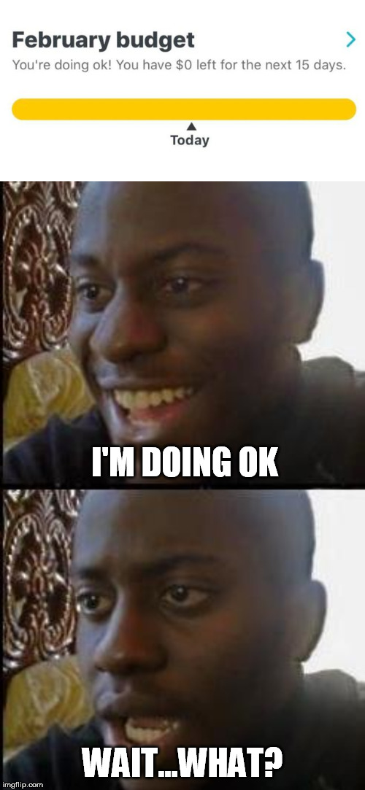

Python
Notes:
Selection Bump: is going to the cloud smart?
- To do it well, I need to rewrite everything in C#
- What about the costs. The cloud is expensive right? An app service alone is already at least €5/month!

Slide 23




Reviews Source
Review Parser
cron
Reddit Bot
Whisky Reviews
Reddit
Notes:
Selection Bump: is going to the cloud smart?
- To do it well, I need to rewrite everything in C#
- What about the costs. The cloud is expensive right? An app service alone is already at least €5/month!

Slide 24
Reviews Source
Review Parser
timer
Whisky Reviews
Reddit Bot
Reddit
Notes:
Selection Bump: is going to the cloud smart?
- To do it well, I need to rewrite everything in C#
- What about the costs. The cloud is expensive right? An app service alone is already at least €5/month!

Slide 25
Reviews Source
Review Parser
timer
Whisky Reviews
Reddit Bot
Reddit
Notes:
Selection Bump: is going to the cloud smart?
- To do it well, I need to rewrite everything in C#
- What about the costs. The cloud is expensive right? An app service alone is already at least €5/month!

Slide 26

Reviews Source
Review Parser
timer
Whisky Reviews
Reddit Bot
Reddit
Credentials
Notes:
Selection Bump: is going to the cloud smart?
- To do it well, I need to rewrite everything in C#
- What about the costs. The cloud is expensive right? An app service alone is already at least €5/month!

Slide 27
Reviews Source
Review Parser
timer
Whisky Reviews
Reddit Bot
Errors & Metrics
Reddit
Credentials
Notes:
Selection Bump: is going to the cloud smart?
- To do it well, I need to rewrite everything in C#
- What about the costs. The cloud is expensive right? An app service alone is already at least €5/month!

Slide 28
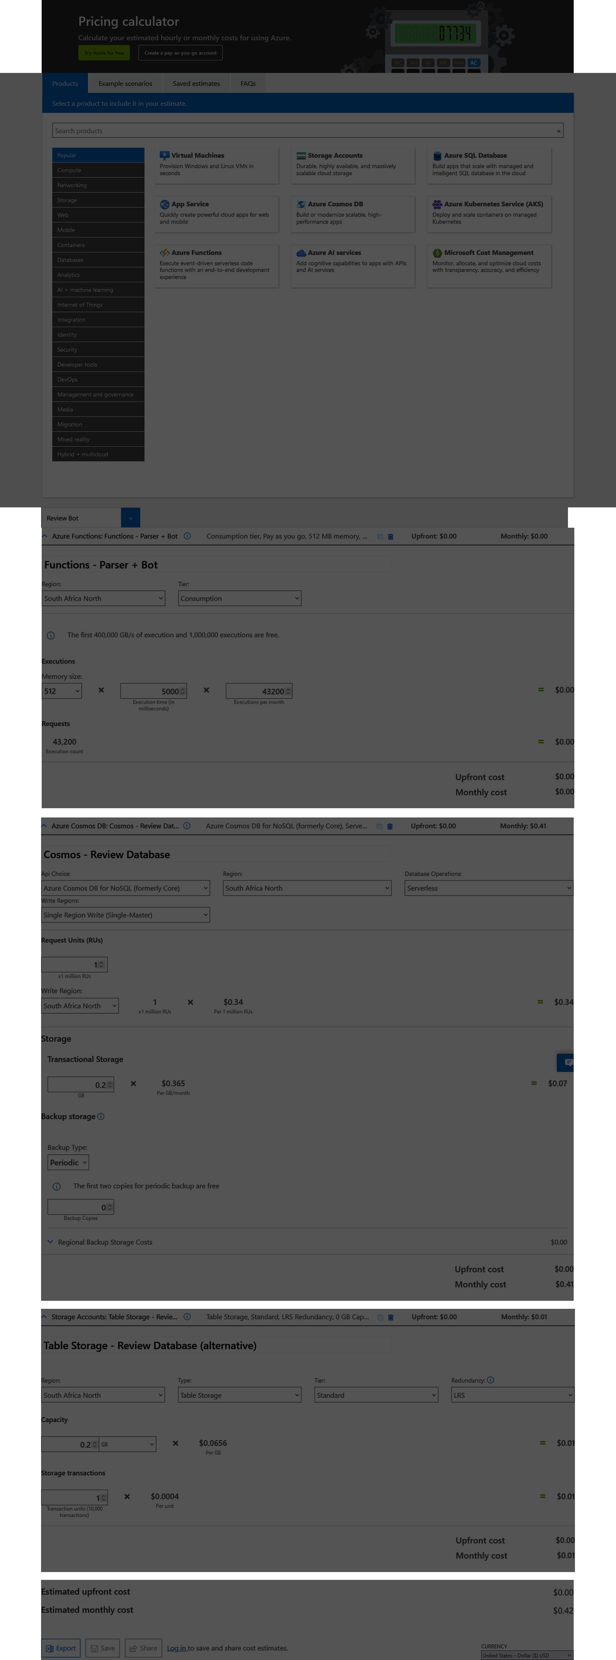
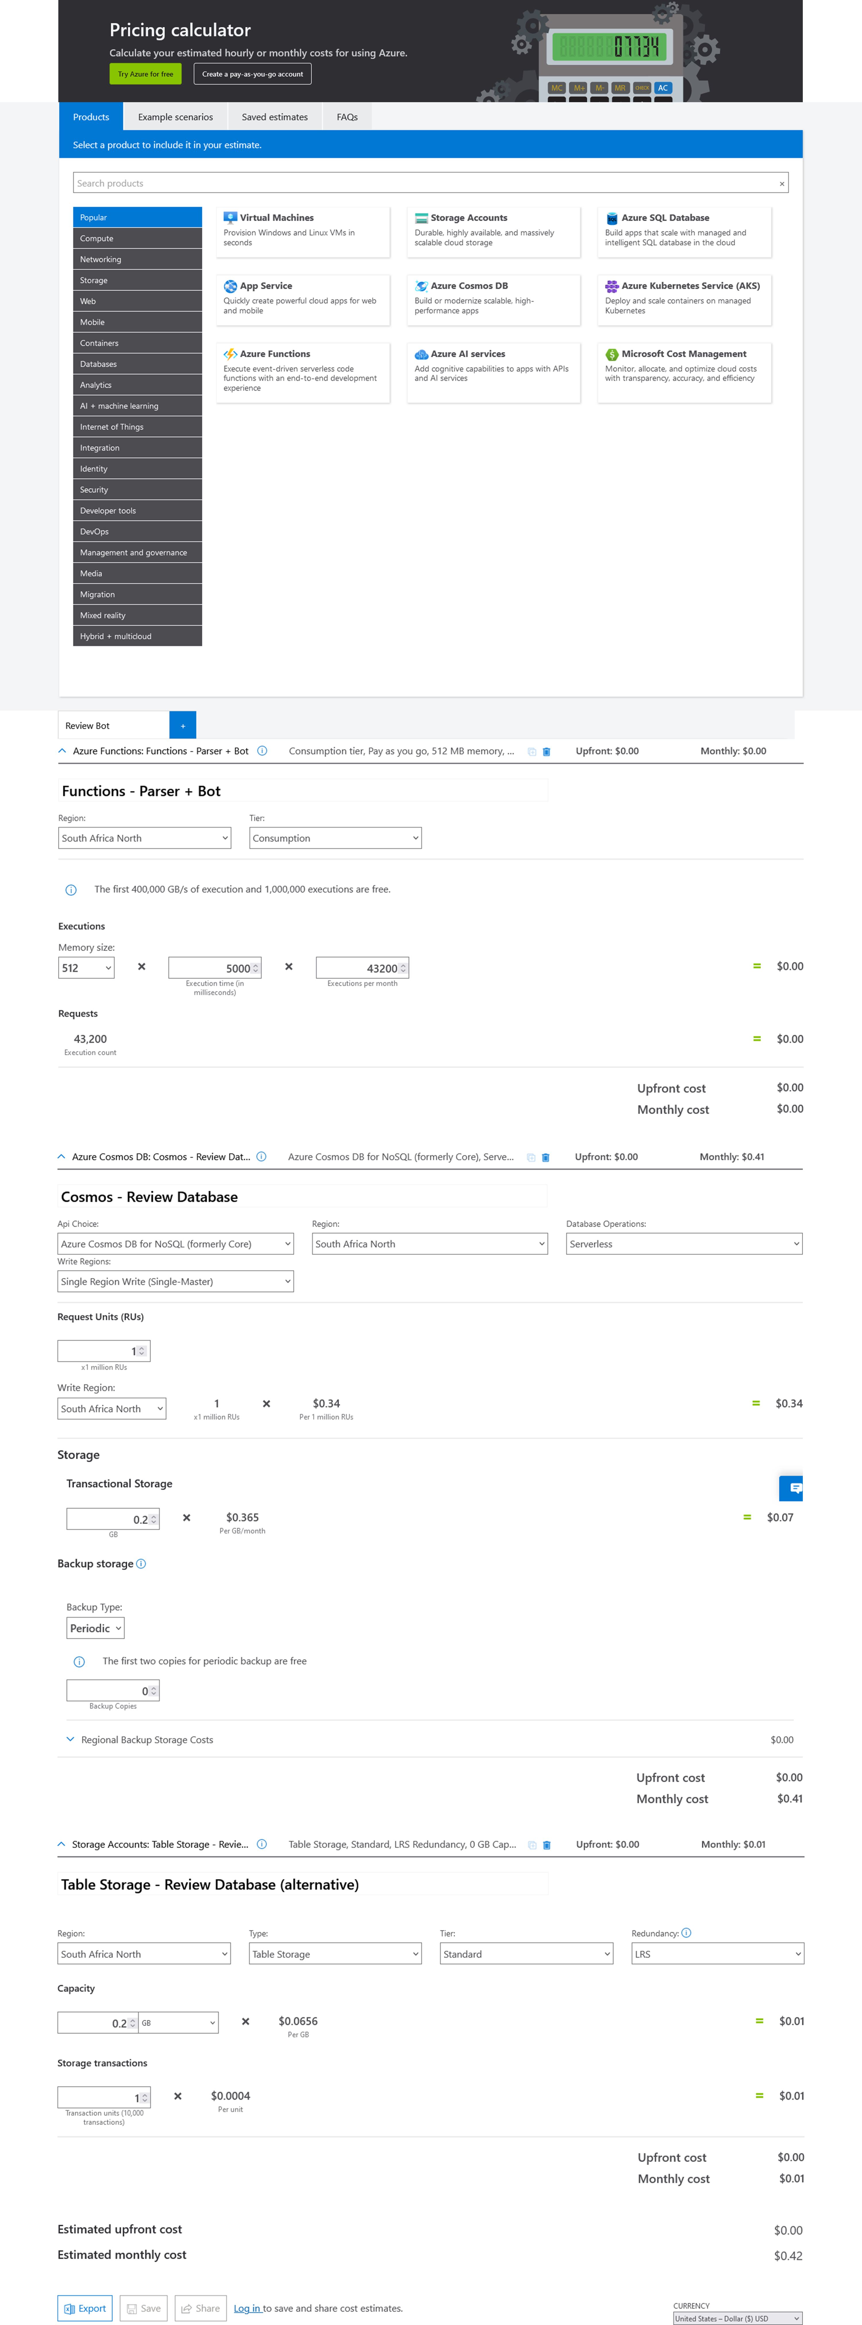
Notes:
Selection Bump: is going to the cloud smart?
- To do it well, I need to rewrite everything in C#
- What about the costs. The cloud is expensive right? An app service alone is already at least €5/month!

Slide 29
Notes:
Selection Bump: is going to the cloud smart?
- To do it well, I need to rewrite everything in C#
- What about the costs. The cloud is expensive right? An app service alone is already at least €5/month!

Slide 30
Notes:
Selection Bump: is going to the cloud smart?
- To do it well, I need to rewrite everything in C#
- What about the costs. The cloud is expensive right? An app service alone is already at least €5/month!

Slide 31
Notes:
Selection Bump: is going to the cloud smart?
- To do it well, I need to rewrite everything in C#
- What about the costs. The cloud is expensive right? An app service alone is already at least €5/month!

Slide 32
Notes:
Selection Bump: is going to the cloud smart?
- To do it well, I need to rewrite everything in C#
- What about the costs. The cloud is expensive right? An app service alone is already at least €5/month!

Slide 33
Notes:
Selection Bump: is going to the cloud smart?
- To do it well, I need to rewrite everything in C#
- What about the costs. The cloud is expensive right? An app service alone is already at least €5/month!

Slide 34
Migration

Slide 35
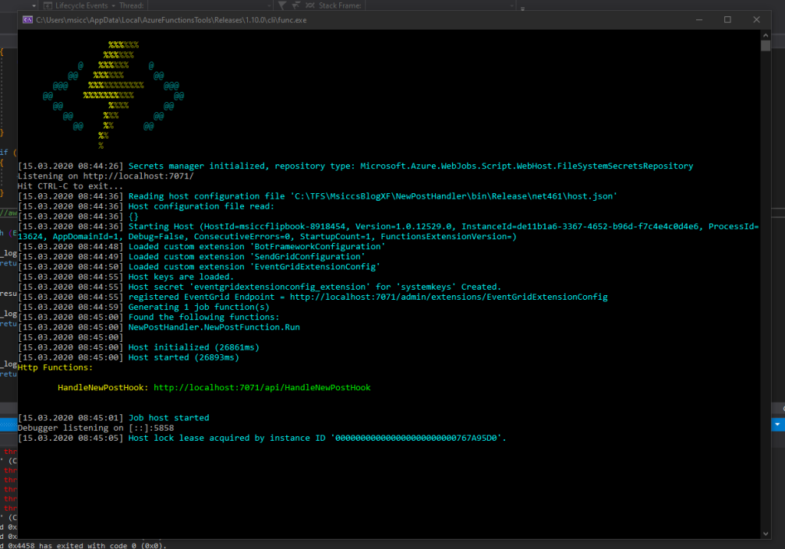

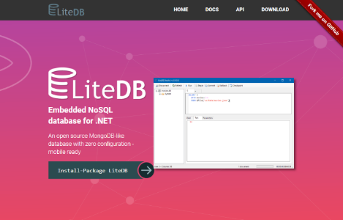
Notes:
Inauguration:
- Working with Azure Functions Core Tools locally
- Migrating from SQLite to LiteDB (SQL -> NoSQL)
- Sending metrics and errors from local to Azure Monitor

Slide 36
Reviews Source
Review Parser
cron
Reddit Bot
Whisky Reviews
Reddit
Notes:
Inauguration:
- Working with Azure Functions Core Tools locally
- Migrating from SQLite to LiteDB (SQL -> NoSQL)
- Sending metrics and errors from local to Azure Monitor

Slide 37



Reviews Source
Review Parser
cron
Reddit Bot
Whisky Reviews
Errors & Metrics
Reddit
Notes:
Inauguration:
- Working with Azure Functions Core Tools locally
- Migrating from SQLite to LiteDB (SQL -> NoSQL)
- Sending metrics and errors from local to Azure Monitor

Slide 38
Reviews Source
Review Parser
timer
Whisky Reviews
Reddit Bot
Errors & Metrics
Reddit
Credentials
Notes:
Selection Bump: is going to the cloud smart?
- To do it well, I need to rewrite everything in C#
- What about the costs. The cloud is expensive right? An app service alone is already at least €5/month!

Slide 39
Notes:
Crisis:
Errors occurred again!

Slide 40
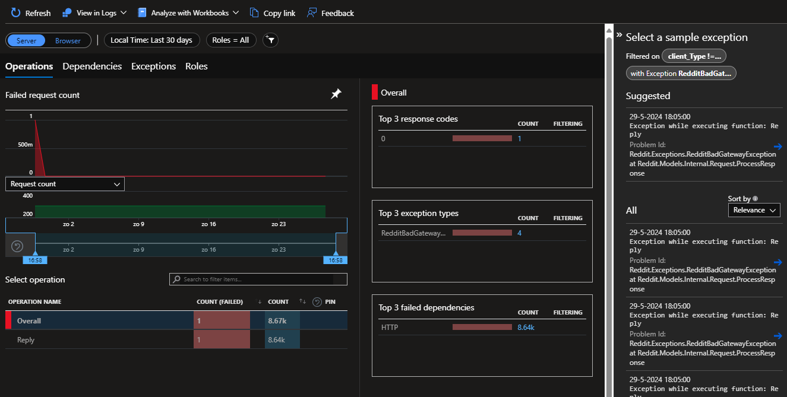


Notes:
But this time we have error logs and pipelines to easily fix it ☺

Slide 41
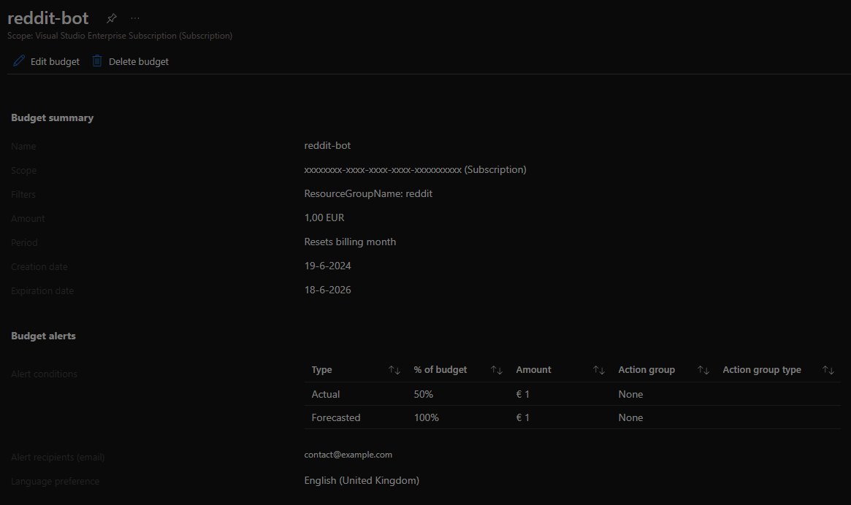
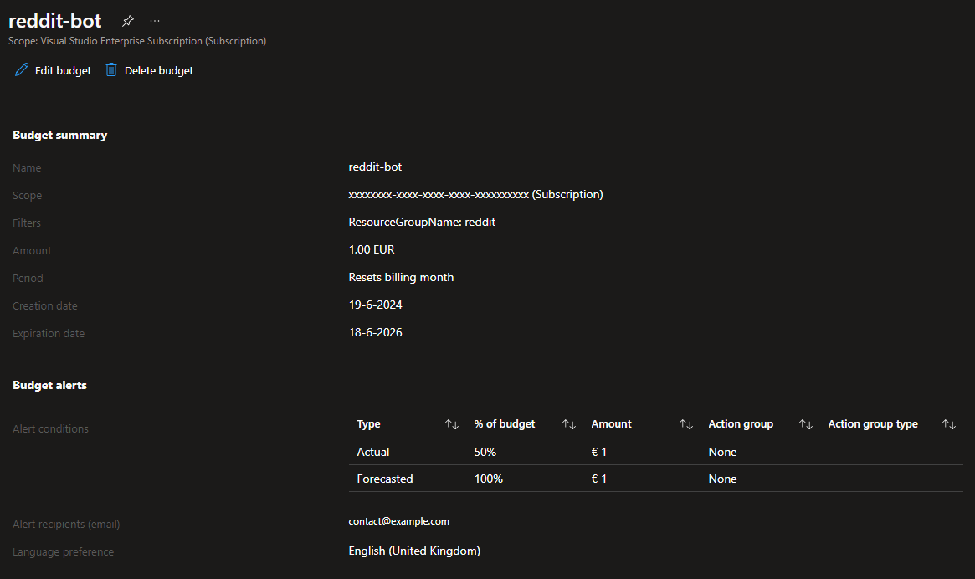
Notes:
Setting up Budget Alerts
Actual: we’ve hit it
Forecasted: we are going to hit it

Slide 43
Notes:
Crisis:
Errors occurred again!

Slide 44
Notes:
Crisis:
Errors occurred again!

Slide 45
Notes:
Who’s feeling motivated to start building apps in Azure themselves?

Slide 46
Learning

Slide 47

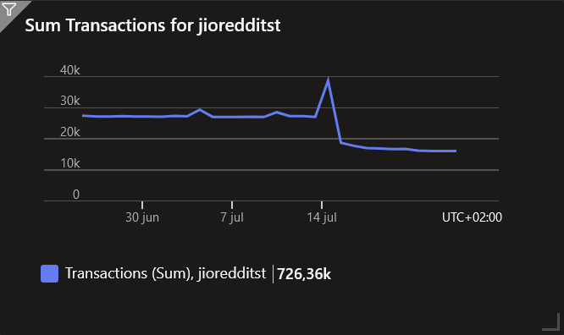
-40%
Notes:
I’m actually hitting my budget pretty fast
- Forgot Serverless Functions use Storage a lot!

Slide 48

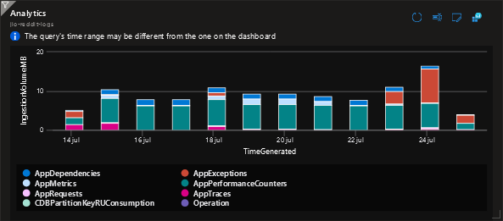
-90%
Notes:
Also, logging. Functions generate a lot of information logs.
Especially AppPerformanceCounters

Slide 49
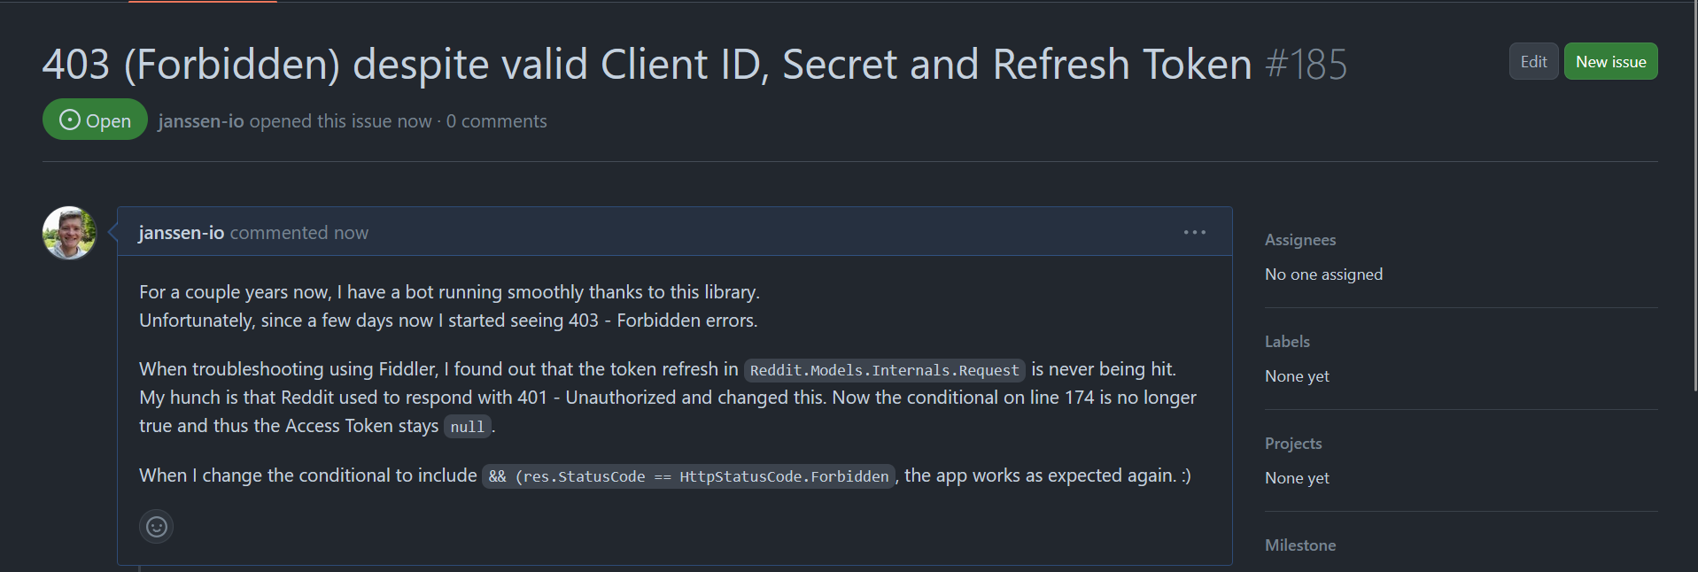
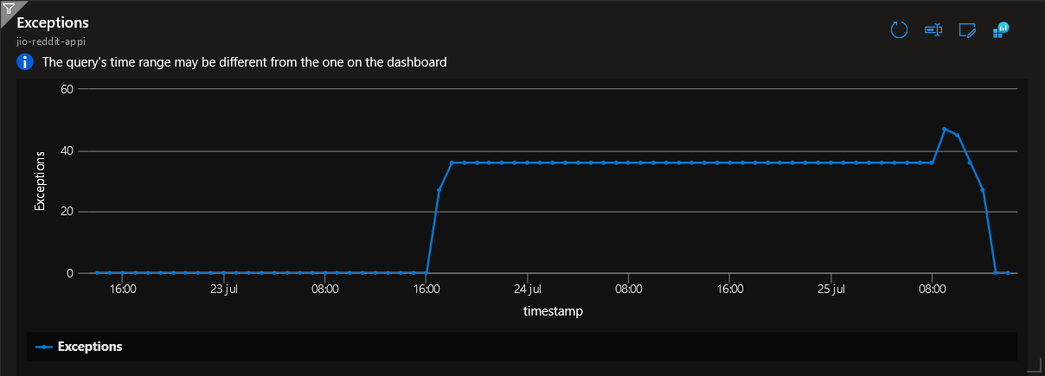


Slide 50
Conclusion

Slide 51


Notes:
Pricing Calculator
Still requires knowledge of how resources are consumed!

Slide 52


Notes:
Monitor the variables that affect
CDB: RU/s
Func: GB/s
Storage: Transactions (and GB)
Monitor: Ingestion (and retention)

Slide 53


Notes:
Choose your services wisely
Big pallet of choices
Keep an eye on the costs

Slide 54

GitHub: 2,000 CI/CD minutes free Pricing · Plans for every developer (github.com)
Azure Functions: First 400,000 GB-s/month free https://azure.microsoft.com/en-us/pricing/details/functions/
Azure CosmosDB: 1,000 RU/s free https://learn.microsoft.com/en-us/azure/cosmos-db/free-tier Azure Application Insights: 5 GB/month + 90 days retention free
https://azure.microsoft.com/en-us/pricing/details/monitor/
Monitor your spending with Azure Budget! https://learn.microsoft.com/en-us/azure/cost-management-billing/costs/tutorial-acm-create-budgets
Notes:
Some light reading

Slide 55









THANK YOU TO OUR SPONSORS!

Slide 56

Session Feedback
Session Track
Azure
Session Name
Azure on a Budget: Professional Insights for Pet Project Delights
Slides https://github.com/Experts-Live-Kenya

